Slide 1
React JS

Slide 2
React JS
React is a JavaScript library for building user interfaces.
React is used to build single-page applications.
React allows us to create reusable UI components.

Slide 3
Run React in Browser
Step 1: Open https://codesandbox.io
Step 2: Click on Create button and choose React.
Step 3: Now you can code inside App.jxs file.

Slide 4
Node (npm) setup
Step 1: First check if NodeJS is installed in your system using command: node –v
Step 2: If the command is not recognized, then follow the step 3
else if you got some version like v16.2.0 then skip all below steps.
Step 3: Installed node js by downloading the recommended one : https://nodejs.org
Step 4: Next > next > …
Step 5: Repeat steps from step 1.

Slide 5
Create React App
npx create-react-app folder-name
Folder name shouldnot contain capital letters or space.
cd folder-name
npm start
NPM stand for Node Package Manager.
NPX stand for Node Package eXecute

Slide 6
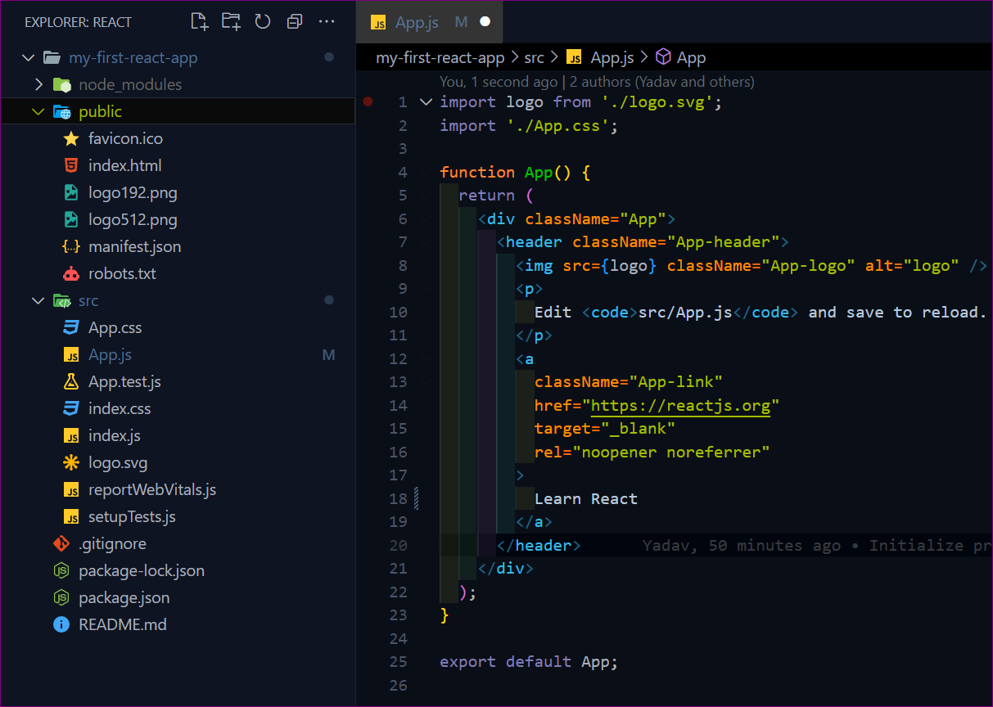
Repository Overview – default

Slide 7
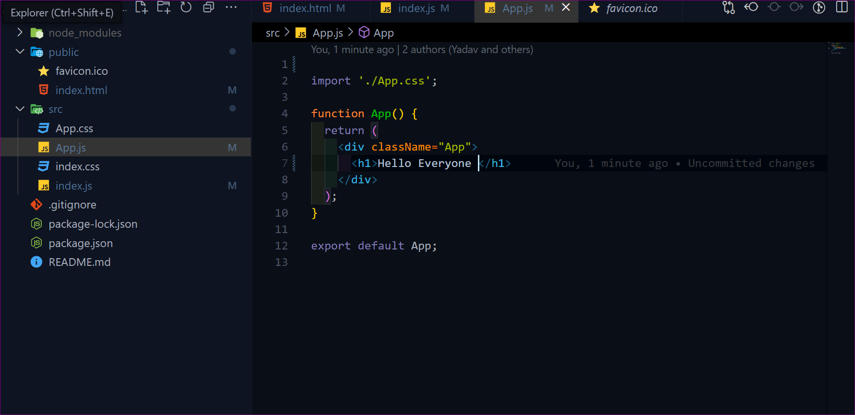
Repository Overview – after cleanup

Slide 8
Components
Components are like JS functions that return HTML(XML) element.
Components are independent and reusable bits of code.
They serve the same purpose as JavaScript functions, but work in isolation and return HTML.
Components are also called as building blocks of react application.
Components come in two types, Class components and Function components.

Slide 9
JSX
JSX stands for JavaScript XML.
JSX allows us to write HTML in JavaScript page.
Expressions in JSX
With JSX you can write expressions (JS) inside curly braces { }.
const myElement = <h1> React is {5 + 5} times better with JSX </h1>;

Slide 10
Create & Render a component
Let’s create a functional component:
function Car() {
return <h2>Hi, I am a Car!</h2>;
}
Rendering multiple element in a Component.
Rendering a Component in <App />

Slide 11
React Props
Props are arguments passed into React components.
React Props are like function arguments in JavaScript and attributes in HTML.
<Car brand="Ford" />;
function Car( props ) {
return <h2>Hi, I am a { props.brand } !</h2>;
}
Destructuring props.

Slide 12
Destructuring props.
<Car brand="Ford" />;
function Car({ brand }) {
return <h2>Hi, I am a { brand } !</h2>;
}

Slide 13
Button & Events
Just like HTML DOM events, React can perform actions like click, change, mouseover etc.
React events are written in camelCase syntax: onClick instead of onclick.
React event handlers are written inside curly braces: onClick={shoot}
function Car( props ) {
const shoot = () => {
alert(" Nice car choice ! ");
}
return <>
<button onClick={shoot}>Take the shot!</button>
<h2> Hi, I am a { props.brand } ! </h2>;
</>
}

Slide 14
Reusing Component
function Car(props) {
return <li>I am a { props.brand }</li>;
}
function App() {
return ( <>
<h1> Who lives in my garage? </h1>
<ul>
<Car brand=" Ford " />
<Car brand=" BMW " />
<Car brand=" Audi " />
</ul>
</> );
}

Slide 15
Rendering component Multiple time
function Car(props) {
return <li>I am a { props.brand }</li>;
}
function App() {
const cars = ['Ford', 'BMW', 'Audi'];
return (
<>
<h1>Who lives in my garage?</h1>
<ul> { cars.map( (car) => <Car brand={car} />) } </ul>
</>
);
}

Slide 16
Form in React
function MyForm() {
return (
<form>
<label>Enter your name: </label>
<input type="text" />
</form>
)
}

Slide 17
Ternary Operator
The ternary operator is a simplified conditional operator like if / else.
Syntax: condition ? <expression if true> : <expression if false>
Here is an example using if / else:
if (authenticated) {
renderApp();
} else {
renderLogin();
}
Here is the same example using a ternary operator:
authenticated ? renderApp() : renderLogin();

Slide 18
Conditional Rendering - Element
function App() {
const isLoggedIn = true;
let text;
if (isLoggedIn) {
text = <h1> Welcome </h1>;
} else {
text = <h1> Please Login First </h1>;
}
//how to write above if-else using ternary operator?
return( <div> {text} </div> )
}

Slide 19
Conditional Rendering - Component
function Failed() {
return <h1> You have failed the exam, sorry! </h1>;
}
function Passed() {
return <h1> You have passed the exam, successfully! </h1>;
}
function App() {
const marks = 42;
if ( marks > 35 )
return <Passed />;
else
return <Failed />;
}
Next: 1.pass props also 2.Condition elements rendering using ternary operator.

Slide 20
Flow Structure of React App
We have only one HTML page (index.html) that contains a div with an ID.
We have a javascript page named index.js that targets the above div
and render a component (App) over it.
This app component is also called as root or main component. Since it contains various other components that return HTML which is displayed in the browser.

Slide 21
Inline CSS
const Header = () => {
return <h1 style={{color: "red"}}>Hello Style!</h1>
}
camelCased Property Names:
const Header = () => {
return <h1 style={{backgroundColor: "lightblue"}}>Hello Style!</h1>
}
Cons: The code quicky becomes unreadable.

Slide 22
CSS as object
const Header = () => {
const myStyle = {
color: "white",
backgroundColor: "DodgerBlue",
padding: "10px",
fontFamily: "Sans-Serif"
};
return <h1 style={myStyle}>Hello Style!</h1>
}

Slide 23
External CSS
import Car from "./car/Car"
import './App.css';
function App() {
const myCarCollection = ["Ford", "BMW", "Honda", "Toyota", "Audi", "Tesla"];
return (
<div>
<h1> Who lives in my garage? </h1>
{myCarCollection.map((abc, ind) =>
<Car name={abc} index={++ind}/>
)}
</div>
)
}
export default App;

Slide 24
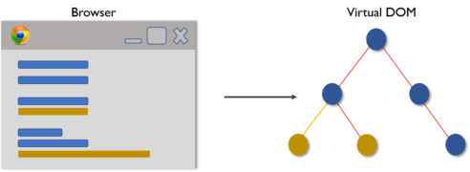
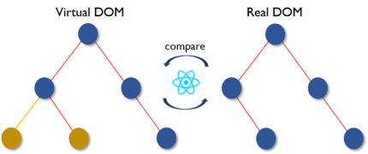
Virtual DOM
Browser create a DOM for our application, also called a actual dom.
React creates a Virtual DOM of the application component and it’s state.
Now everytime state changes then it compares with the Actual DOM with the virtual DOM, and update that particular part of the application that has been changed, without re-rendering the entire component or application.

Slide 25
List Items
function App() {
return ( <>
<h1> Who lives in my garage? </h1>
<ul>
<li key=“1”>I am a Ford </li>
<li key=“2”> I am a BMW </li>
<li >I am a Audi </li>
</ul>
</> );
}

Slide 26
List Items and Keys
const numbers = [1, 2, 3, 4, 5];
const listItems = numbers.map((number) =>
<li key={number.toString()}>
{number}
</li>
);
const todos = ["Ford", "BMW", "Honda", "Toyota", "Audi", "Tesla"]; const todoItems = todos.map((todo, index) =>
// Only do this if items have no stable IDs
<li key={index}>
{todo.text}
</li>
);
todos.push(“Tata”);

Slide 27

Hooks
Hooks are a feature in React that allow us to use state, lifecycle methods, and other React features inside a functional component.
Some of the popular hooks are useState and useEffect.
In order to use a hook, first we need to import it from react:
import { useState } from 'react';
import { useEffect } from 'react';
OR
import { useState, useEffect } from 'react';

Slide 28
useState Hook
The React useState Hook allows us to declare variable that can store data and react can track the state change (modification of the data) in a function component.
Now since react tracks all the state variable change so react can render that specific component which is dependent on that state and no need to re-render the entire applicaton.
What type of data, state can store?
The useState Hook can be used to keep track of any data type like strings, numbers, booleans, arrays, objects, or mix datatype.
import { useState } from "react";
function App() {
const [color, setColor] = useState("red");
return <h1>My favorite color is {color}!</h1>
}

Slide 29
useState Hook - Updating state
import { useState } from 'react';
function App() {
const [count, setCount] = useState(0);
return (
<div>
<h1>You clicked {count} times</h1>
<button onClick={() => setCount(count + 1)}>
Increment Count
</button>
</div>
);
}
export default App;

Slide 30
useState Hook vs JS Variable
import { useState } from 'react';
function Welcome() {
return <h1>Welcome back!, You have successfully Login</h1>;
} function Logout() {
return <h1>You are logout successfully, Please sign in to use the app.</h1>;
}
function App() {
const [isLogin, setLogin] = useState(false);
return (
<div>
<h3> Learning useState hook</h3> { isLogin ? <Welcome /> : <Logout /> } <button onClick={setLogin(true)}> Login </button>
<button onClick={setLogin(false)}> Logout </button> </div>
);
};
export default App;

Slide 31
useState Hook vs JS Variable
import { useState } from 'react';
function Welcome() {
return <h1>Welcome back!, You have successfully Login</h1>;
} function Logout() {
return <h1>You are logout successfully, Please sign in to use the app.</h1>;
}
function App() {
const [isLogin, setLogin] = useState(false);
return (
<div>
<h3> Learning useState hook</h3> { isLogin ? <Welcome /> : <Logout /> } <button onClick={setLogin(true)}> Login </button>
<button onClick={setLogin(false)}> Logout </button> </div>
);
};
export default App;

Slide 32
Controlled Components
Controlled Components are those in which form data is handled by the useState hook.
function App() {
const [name, setName] = useState("");
const [email, setEmail] = useState("");
function onSubmit() {
console.log("Name value: " + name);
console.log("Email value: " + email);
}
return (
<div>
<h1> Your Name is : {name} </h1>
<h1> Your Email is : {email} </h1>
<form onSubmit={onSubmit}>
<input value={name} onChange={(e) => setName(e.target.value)}/>
<input value={email} onChange={(e) => setEmail(e.target.value)} />
<input type="submit" value="Submit" />
</form>
</div>
);
}

Slide 33
Uncontrolled Components & useRef
Uncontrolled Components are those in which form’s data is NOT handled by the component’s state.
import { useRef } from "react";
function App() {
const nameRef = useRef(null);
const emailRef = useRef(null);
function onSubmit(e) {
e.preventDefault();
console.log("Name value: " + nameRef.current.value);
console.log("Email value: " + emailRef.current.value);
}
return (
<div>
<h1> Name : {nameRef?.current?.value} </h1>
<form onSubmit={onSubmit}>
<input type="text" ref={nameRef} />
<input type="email" ref={emailRef} />
<input type="submit" value="Submit" />
</form>
</div>
);
}

Slide 34
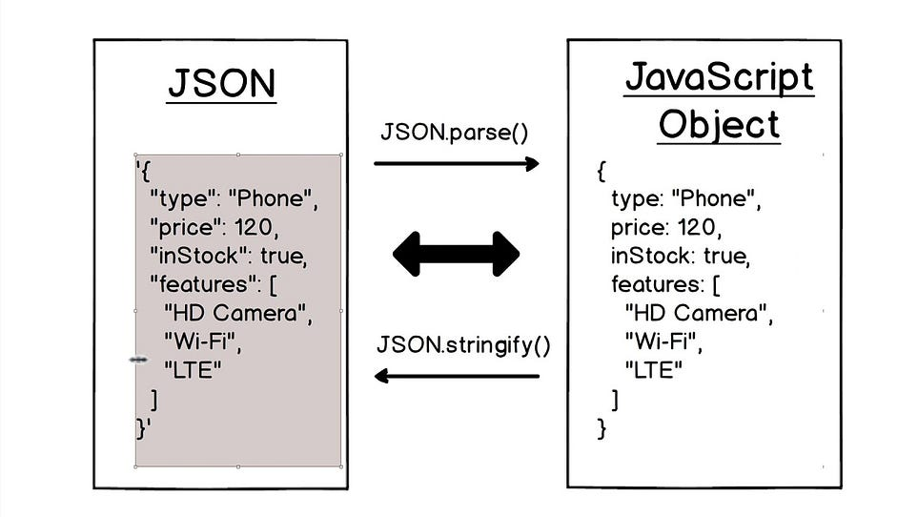
JS Objects vs JSON
JSON Stands for JavaScript Object Notation. We generally send and receive data from the server as JSON. To convert an object to JSON we can wrap all the keys in double quotes and the entire object in a single quote. Or alternatively, we can use methods like JSON.stringify(objName) to convert it to JSON data type. To convert JSON data to an object we can use JSON.parse(jsonVarible).

Slide 35
useEffect Hook
The useEffect Hook allows you to perform side effects in your components.
Some examples of side effects are: fetching data, updating DOM directly, etc.
The useEffect hook accepts two arguments.
Syntax :
useEffect(() => {
}, []);
The first argument is a function we basically fetch data from the API and second argument is an optional array based on the second argument react either render/call the API one time or multiple time.

Slide 36
useEffect Hook
import { useState, useEffect } from "react";
function App() {
const [todo, setTodo] = useState([])
useEffect(() => {
fetch('https://jsonplaceholder.typicode.com/todos/')
.then(response => response.json()) //JSON to JS object.
.then(data => setTodo(data))
},[])
return(
<div>
<h1>Todo List items: </h1>
<ul> {todo.map(item => <li key={item}>{item.title}</li>)}</ul>
</div>
)
}

Slide 37
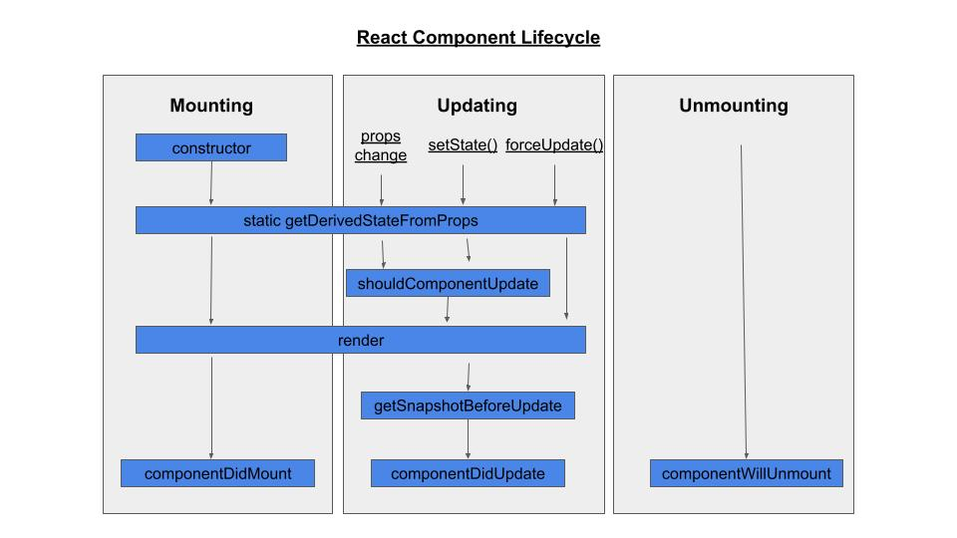
Lifecycle methods - useEffect

Slide 38
Lifecycle methods - useEffect
1. No dependency passed:
useEffect(() => {
//Runs on every stateChange , infinite call issue, Bad practice.
});
2. An empty array: componentDidMount equivalent
useEffect(() => {
// After the JSX is rendered then it is called once.
}, []);
3. Props or state values: componentDidUpdate equivalent
useEffect(() => {
//Runs on the first render
//And any time any dependency value changes
}, [prop, count]);
4. Inside useEffect we can also perform somecleanup: componentWillUnmount
useEffect(() => {
return () => {
console.log("cleaned up");
}
}, []);

Slide 39
Axios
Axios is a better alternative to fetch() method.
First, install the package: npm i axios
import axios from "axios";
export default function App() {
const [post, setPost] = React.useState(null);
useEffect(() => {
axios.get("https://jsonplaceholder.typicode.com/posts/1")
.then((response) => {
setPost(response.data);
})
.catch((error) => console.error(error));
}, []);
return (
<div>
<h1>{post.title}</h1>
<p>{post.body}</p>
</div>
);
}

Slide 40
async await with Axios
const axios = require('axios');
async function fetchData(){
try {
let response = await axios.get('/api_url/');
console.log(response);
}
catch(err){
console.error(err);
}
}
useEffect(() => {
fetchData()
}, [])

Slide 41
Function to Class Components
function Greeting(){
const date = new Date()
const hours = date.getHours()
let timeOfDay;
if(hours<12){
timeOfDay = "morning"
}
else if(hours>=12 && hours <17){
timeOfDay = "afternoon"
}else{
timeOfDay = "night"
}
return(
<h1> Good { timeOfDay } to you </h1>
)
}
//class App extends React.Component{
render() {
return()
}
}
function App(){
return(
<div>
<Header userName="Dipak" />
<Greeting />
</div>
)
}
function Header(props){
return(
<>
<p> Welcome, {props.userName} </p>
</>
)
}

Slide 42
Function to Class Components
function Greeting(){
const date = new Date()
const hours = date.getHours()
let timeOfDay;
if(hours<12){
timeOfDay = "morning"
}
else if(hours>=12 && hours <17){
timeOfDay = "afternoon"
}else{
timeOfDay = "night"
}
return(
<h1> Good { timeOfDay } to you </h1>
)
}
//class App extends React.Component{
render() {
return()
}
}
function App(){
return(
<div>
<Header userName="Dipak" />
<Greeting />
</div>
)
}
function Header(props){
return(
<>
<p> Welcome, {props.userName} </p>
</>
)
}

Slide 43
State in Class Components
class Car extends React.Component {
constructor(props) {
super(props);
this.state = {
model: "Mustang",
color: "red",
};
}
changeColor = () => {
this.setState({color: "blue"});
}
render() {
return (
<div>
<h1> It is a {this.state.model} in {this.state.color} Color </h1>
<button onClick={this.changeColor}> Change color</button>
</div>
);
}
}

Slide 44
Default Export vs Named Export
In order to reuse a function, class, object, etc we need to export them basically means exposing them to the entire application. There are two ways to export them:
1. Named exports are useful for exporting several values from the same file. During the import, one will be able to use the same name to refer to the corresponding value.
// ex. importing 2 named exports & giving a named import a different name by using "as":
import { MyComponent, MyComponent2 as MyNewComponent } from "./MyComponent";
// exports two functions/components from ./MyComponent.js file
export const MyComponent = () => {}
export const MyComponent2 = () => {}
2. There is only a single default export per module.
// import
import MyDefaultComponent from "./MyDefaultExport";
// export
export default const MyComponent = () => {}

Slide 45
Why React Component Render Twice? – Strict Mode
import React from 'react';
import ReactDOM from 'react-dom/client';
import App from './App';
const root = ReactDOM.createRoot(document.getElementById('root'));
root.render(
<React.StrictMode>
<App />
</React.StrictMode>
);

Slide 46
PropTypes in React
npm install prop-types –save
import PropTypes from 'prop-types';
function Greeting(props){
return (
<h1>Hello, {props.name}</h1>
); }
Greeting.propTypes = {
name: PropTypes.string.isRequired,
age: PropTypes.number
};
Type | Class | Example
String | PropType.string | “helllo”
Object | PropType.object | {name: “Rohit”}
Number | PropType.number | 10
Boolean | PropType.bool | true/false
Function | PropType.func | const say = {console.log(“hello”)}

Slide 47
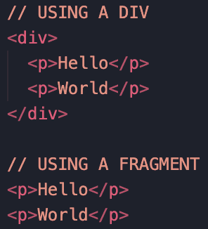
Fragment vs Div
In React, "Fragment" and "Div" are used interchangeably.
Fragment don’t add an extra elements in the DOM.
export default function App() {
return (
<div>
<p>Hello</p>
<p>World</p>
</div>
);
}
export default function App() {
return (
<React.Fragment>
<p>Hello</p>
<p>World</p>
</React.Fragment>
);
}

Slide 48
styled-component
npm install styled-components
import styles from "styled-components";
const Button = styles.button`
background-color: ${props => props.bgcolor || "green"}; //green is the default
border: none;
border-radius: 5px;
color: ${props => props.primary ? "yellow" : "white"};
cursor: pointer;
margin: 50px;
padding: 10px; //all the css is arranged in alphabetical order.
`
export default Button;
import Button from "./components/styled/Button"
function App() { return (
<div>
<Button primary> Hello Everyone</Button>
<Button bgcolor="red"> Hello Everyone 2</Button>
</div>
);
}

Slide 49
react-router-dom – index.js page
Create React App doesn't include page routing. So we use React Router, which is the most popular solution.
npm i react-router-dom
import {BrowserRouter} from "react-router-dom";
const root = ReactDOM.createRoot(document.getElementById('root'));
root.render(
<React.StrictMode>
<BrowserRouter>
<App />
</BrowserRouter>
</React.StrictMode>
);
https://codesandbox.io/s/dazzling-ptolemy-y1yp5p?file=/src/Home.js:0-88

Slide 50
react-router-dom – App component
import { Navbar } from "./Navbar"
import { Routes, Route } from "react-router-dom";
function App() {
return (
<Container>
<Navbar/>
<Routes>
<Route path="/" element={<Home/>} />
<Route path="/about" element={<About/>} />
<Route path="/contact" element={<Contact/>} />
<Route path="/blog" element={<Blog/>} />
<Route path="/blog/:id" element={<Blogs/>} />
{/* here anything after /blog/ is called as parameter */}
<Route path="*" element={<NotFound/>} />
</Routes>
</Container>
);
}

Slide 51
react-router-dom – NavBar component
import React from 'react'
import Styled from "styled-components";
import { Link } from "react-router-dom";
export function Navbar() {
return (
<Container>
<StyledLink to={"/"}> Home </StyledLink>
<div>
<StyledLink to={"/about"}>About</StyledLink>
<StyledLink to={"/blog"}>Blog</StyledLink>
<StyledLink to={"/contact"}>Contact</StyledLink>
</div>
</Container>
)
}
const Container = Styled.ul`
margin-top: 0;
display: flex;
justify-content: space-between;
align-items: center; //vertical-align
height: 45px;
box-shadow: 1px 3px rgb(60, 60, 60, 0.4);
`
const StyledLink = Styled(Link)`
padding-right: 20px;
color: black;
padding-right: 40px;
text-decoration: none;
`

Slide 52
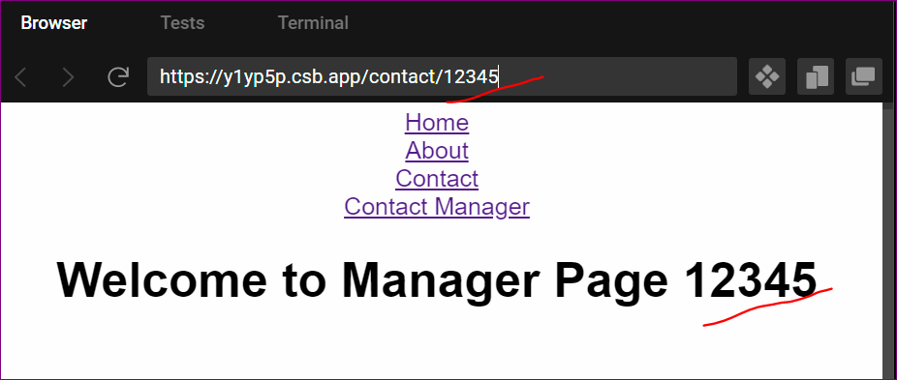
react-router-dom – useParams
import { useParams } from "react-router-dom";
const Manager = () => {
const { id } = useParams();
return <h1> Welcome to Manager Page {id} </h1>;
};
export default Manager;

Slide 53
Redux-toolkit
What is Redux?
Redux is an open-source JavaScript library for managing and centralizing application state. It is most commonly used with libraries such as React or Angular for building user interfaces.
Why do we need redux?
Redux is used to solve the problem of state lifting or prop drilling. Redux allows you to manage your app's state in a single place and keep changes in your app more predictable and traceable.
Data flow is unidirectional in react js. It is always parent to child. But there are some workarounds to pass data from child to parent or we can use a state management library like Redux.
https://redux-toolkit.js.org/tutorials/quick-start

